Slide 1
Proposal for a SINEX extension –meta data block
Bernd Richter, Carey Noll
Wolfgang Schwegmann
GGOS DIS WG

Slide 2
Need of Metadata
Meta data describes:
  what is the content,
  where one can find the data set,
  when and by whom a particular set of data was collected.
Meta data is essential for understanding information stored in data warehouses and has become increasingly important in XML-based Web applications.
Metadata does not contain data
nor replace a data base

Slide 3
Use of Metadata
The ISO 19115 standard for geographic metadata is widely used in the GIS world and recommended e.g. by FGDC, OGC and GEOSS.
It is proposed to follow the same strategy for the GGOS to keep consistency with the main stream.
Cross mapping allows the use of different metadata standards as long as the necessary information covers the requested formalities and are based on XML technology. E.g. the NASA proposed Directory Interchange Format (DIF) and ISO 19115 a crosswalk is provided .

Slide 4
GGOS Portal and Meta Data
Session 6 GGOS Portal and Metadata Flow, UAW, Monterey,
White paper with detailed information at http://www.iers.org/meetings

Slide 5
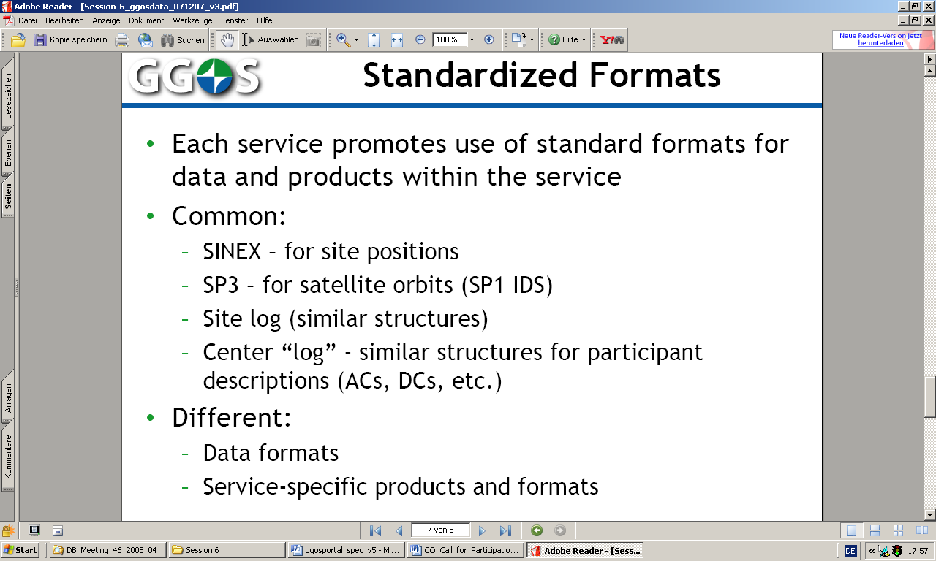

Slide 6
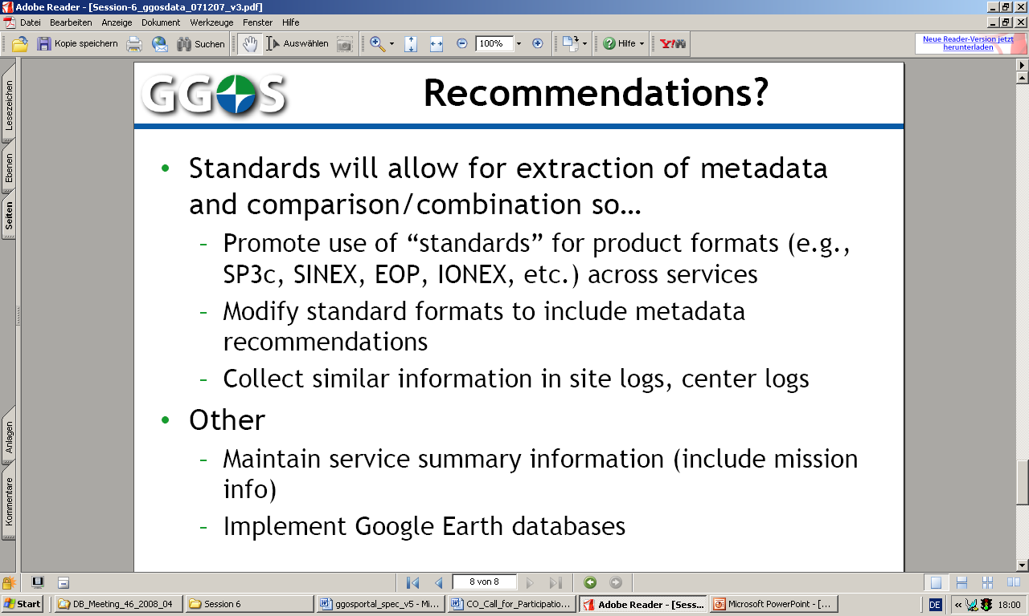

Slide 7
Meta data block in SINEX: Definition
Definition of an ISO meta data set containing 47 elements.
The core meta data set is restricted to allow search, analyze, etc. and minimize the time necessary to create the set.
Draft of a core meta data block for the SINEX-Format:
  Introduction of a new block: FILE/METADATA
  Description of the Keyword-pair

Slide 8
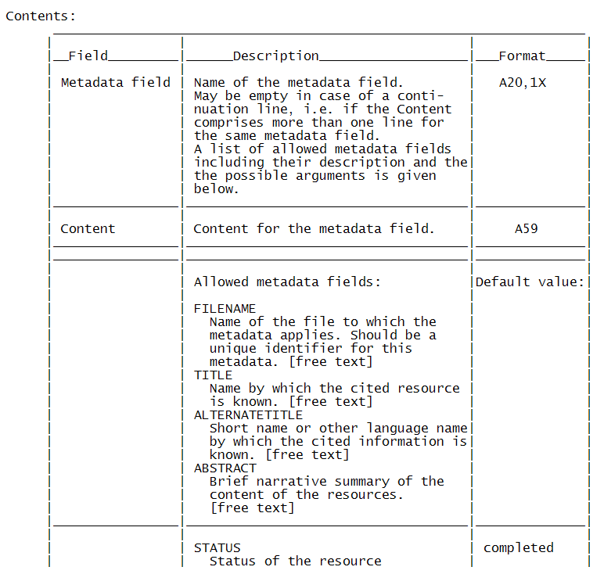
Meta data block in SINEX: Definition

Slide 9
Meta data block in SINEX: Example
+FILE/METADATA
*-------------------------------------------------------------------------------
* Example for the contents of the SINEX FILE/METADATA Block for file
* DGF07063L7_b03.snx.gz
*Metadata field Content
*
FILENAME DGF07063L7_b03.snx.gz
TITLE GGOS-D DGFI SLR solution 2nd iteration version b03 (GFZ)
ALTERNATETITLE GGOS-D DGFI SLR solution
ABSTRACT Weekly SINEX file of DGFI SLR solution for GGOS-D
(single technique solution).
Standards, models and parameterization are chosen with
respect to the GGOS-D conventions for the 2nd iteration.
With the strict use of common standards within GGOS-D
a consistent reprocessing and combination of the space
geodetic techniques should be achieved.
IDENTIFIER DGF07063L7_b03
STATUS completed
LANGUAGE en
CHARSET 8859part2
DATE 2007-11-13 13:46:18
DATETYPE creation

Slide 10
Meta data block in SINEX: Example
FORMATNAME SINEX
FORMATVERSION 2.00
MEDIUMNAME onLine
LINKAGE ftp://ftp.ggos-d.de/data/test/2004/GFZ/GFZ07063L7_b03.snx.gz
SUPPLEMENTALINFO
TOPICCATEGORY geoscientific Information
THESAURUSNAME GCMD Keywords
THESAURUSDATE 2008-02-07 17:44:52
THESAURUSLINKAGE http://gcmd.gsfc.nasa.gov/Resources/valids/archives/keyword_list.html
THESAURUSORGNAME NASA Goddard Space Flight Center
KEYWORDS Solid Earth > Geodetics/Gravity > Gravitational Field,
Solid Earth > Geodetics/Gravity > Polar Motion,
Solid Earth > Geodetics/Gravity > Reference Systems,
Solid Earth > Geodetics/Gravity > Rotational Variations,
Solid Earth > Geodetics/Gravity > Satellite Orbits,
SLR > Satellite Laser Ranging
FEES
USECONSTRAINTS restricted
USELIMITATION
DATAQUALITY Input data: LAGEOS-1/2 SLR data provided by EDC
Software: DOGS_OC 5.00 and DOGS_CS 4.08
Hardware: PC, dual core 2,4 GHz, 2Gbyte Mem, Linux, SuSE 10.3
REFSYSNAME ITRF2000

Slide 11
Selected keywords as used in the Global Change Master Directory (GCMD)
For full information please go to http://gcmd.gsfc.nasa.gov/Resources/valids/gcmd_parameters.html.
Olsen, L.M., G. Major, K. Shein, J. Scialdone, R. Vogel, S. Leicester, H. Weir, S. Ritz, T. Stevens, M. Meaux, C.Solomon, R. Bilodeau, M. Holland, T. Northcutt, R. A. Restrepo, 2007 .
NASA/Global Change Master Directory (GCMD) Earth Science Keywords. Version 6.0.0.0.0
GCMD Earth Science Keywords
TOPIC > TERM > VARIABLE_LEVEL_1
Solid Earth > Geodetics/Gravity > Crustal Motion
Solid Earth > Geodetics/Gravity > Geoid Properties
Solid Earth > Geodetics/Gravity > Gravitational Field
Solid Earth > Geodetics/Gravity > Gravity
Solid Earth > Geodetics/Gravity > Ocean Crust Deformation
Solid Earth > Geodetics/Gravity > Polar Motion
Solid Earth > Geodetics/Gravity > Reference Systems
Solid Earth > Geodetics/Gravity > Rotational Variations
Solid Earth > Geodetics/Gravity > Satellite Orbits
Solid Earth > Tectonics > Plate Boundaries
Solid Earth > Tectonics > Plate Tectonics

Slide 12
Meta data block in SINEX: Example
GEOIDENTIFIER world
WESTBL -180.0
EASTBL +180.0
NORTHBL +90.0
SOUTHBL -90.0
BEGIN 2007-03-04 12:57:12
END 2007-03-10 11:44:51
INDIVIDUALNAME Mueller, Horst, Dr
ORGANISATIONNAME Deutsches Geodaetisches Forschungsinstitut (DGFI)
ROLE originator
PHONE ++49-89-23031-1277
FAX ++49-89-23031-1240
DELIVERYPOINT Alfons-Goppel-Straße 11
CITY Muenchen
ADMINISTRATIVEAREA Bavaria
POSTALCODE 80539
COUNTRY GERMANY
EMAIL mueller@dgfi.badw.de
CONTACTLINKAGE http://www.dgfi.badw.de
MDSTANDARDNAME ISO 19115
MDSTANDARDVERSION 2003
*-------------------------------------------------------------------------------
-FILE/METADATA

Slide 13
Meta data block in SINEX: Use
Separate meta data block
  To collect all information at a specific place
  (easier to check completeness, make changes)
  All keywords should be listed, even it is a zero record to allow automated extraction.
Draft of a core meta data block for the SINEX-Format:
  Will be send for comments to the Technique Services together with examples containing proposed keywords
With the intension to insert the meta data block as soon as possible in regular solutions.

Slide 14
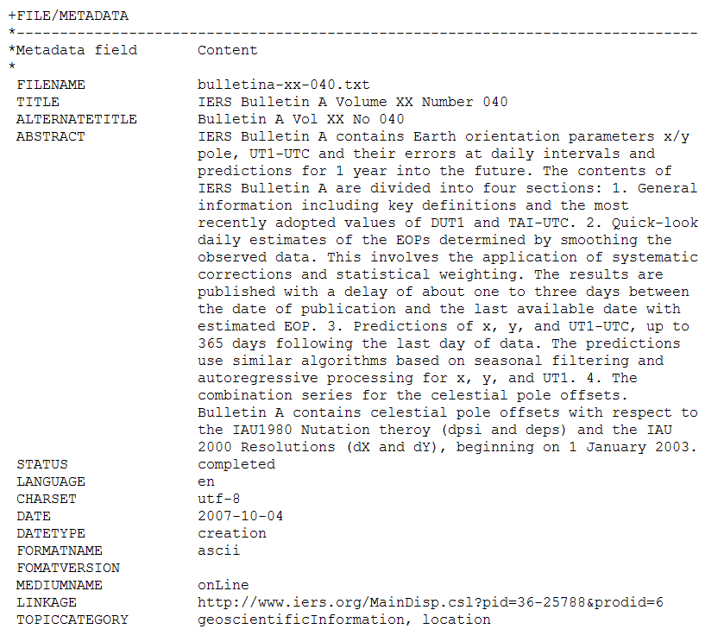
Meta data block: Bulletin A (IERS)

